Slide 1

Genomic Sequence Analysis System
Group 9
Notes:
大家好，我是成员C。今天我将向大家汇报我们生物信息学分析工具中的数据生成与核心算法模块。本次汇报将重点介绍我们如何设计和实现数据集的自动生成、核心数据结构的选择，以及两个关键算法——编辑距离和突变热点检测的具体实现。

Slide 2

Project Overview
In biological research, DNA sequences are constantly affected by mutations such as insertions, deletions, and substitutions, so efficient data structures are essential for managing and processing sequence data. This project applies fundamental data structures to realistic bioinformatics scenarios, demonstrating how appropriate data structure selection improves the efficiency of sequence storage, mutation management, sequence retrieval, and evolutionary analysis. The project also highlights that different biological problems require different data structures, making data structure design a key factor in solving real-world computational biology problems.
Notes:
我们项目的核心目标是构建一个能够处理和分析DNA序列数据的工具。在开发过程中，我们发现获取真实的、带有标注的生物数据非常困难。因此，我的首要任务就是创建一个能够生成高度仿真模拟数据的模块，为后续的算法开发和测试提供基础。今天我将重点介绍这部分工作以及基于这些数据的核心算法。

Slide 3
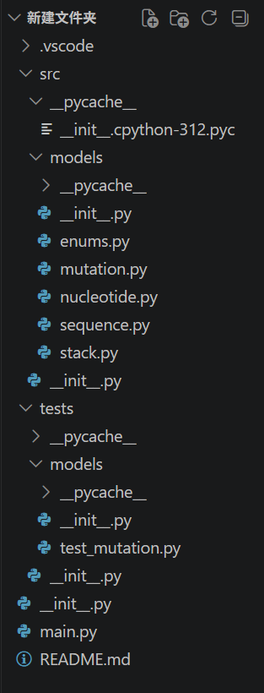
Task 1-3 Preparation
In Tasks 1–3, we first designed the data models, including the nucleotide, sequence, mutation, and enumeration classes. Then implemented the DNA sequence as a doubly linked list, providing operations such as insertion, deletion, substitution, sequence retrieval, subsequence search, and reverse complement generation. Finally, we introduced a stack to record mutation history, enabling mutation application, undo functionality, and history tracking. At the same time, we organized the project into a modular structure, separating source code, test files, and the program entry point to improve readability, maintainability, and future extensibility.
Notes:
generate_sequences 函数是数据生成的第一步。它遵循几个关键规则：首先，固定生成10条序列，分配给3到5个不同的物种。每个物种会先产生一个随机长度的原始序列，然后该物种的其他序列都是通过对这个原始序列进行少量突变得到的。这样设计可以很好地模拟真实世界中同一物种内的遗传变异现象。

Slide 4
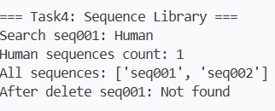
Sequence Library: BST
The code uses a binary search tree (BST) structure, implemented through the `SequenceLibrary` class, with `sequence_id` as the sort key. Each node stores a Sequence object, and insertion, search, and deletion operations are implemented recursively based on key size comparisons. The advantage of this structure lies in its efficient search performance. Through the binary search mechanism, the average time complexity of addition and deletion operations is O(log n)

Slide 5
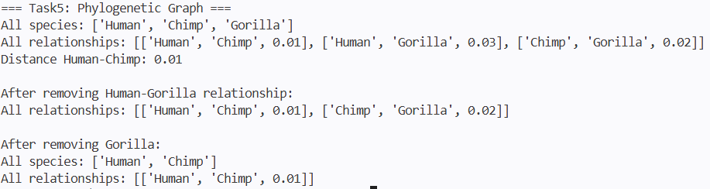
Phylogenetic Graph
The code adopts an undirected graph structure and uses lists to store species and edges. The edges contain two species and their evolutionary distance. The running results show that after adding the three species Human, Chimp, and Gorilla, three evolutionary relationship edges are constructed.The advantages of this structure are that it is simple and intuitive, has low implementation cost, and is suitable for small-scale evolutionary relationship modeling. The undirected graph design accurately reflects the symmetry of the evolutionary distance between species. Dynamic addition and deletion operations are flexible, and relevant edges are automatically cleaned when deleting species to ensure data integrity.

Slide 6



Member C：P1T6,P2T1,P2T2
1.Use Case Presentation用例介绍（whychoose）
2.Design Choices 设计选型与原因
Algorithm Description 算法说明
This bioinformatics simulation tool batch-generates three standard CSV datasets including primate DNA, base mutations and evolutionary distances for downstream evolutionary analysis and mutation algorithm testing.
core：
1._ensure_dir
2._write_csv
3.generate_random_dna_sequence
4._mutate_base
3 csv：
1.generate_sequences
2.generate_mutations
3.generate_distances
4.generate_all_datasets（main schedule）
Modular functions: Separate encapsulation of common IO, DNA generation, mutation and distance logic to eliminate redundant code and support independent calling;
Data structures: Dictionaries for single records and lists for full datasets (natively compatible with csv.DictWriter); Sets for deduplicating mutation positions and distance pairs;
Dual output: Support local CSV storage and in-memory list return, fitting both file archiving and real-time calculation;
Uniform UTF-8 CSV standard with auto folder creation for cross-platform compatibility
Notes:
# Core Logic of Code (Chinese & English Bilingual, Concise Version)
## 1. Use Case Presentation 用例介绍
### Chinese
本程序为生物信息仿真工具，用于批量生成灵长类DNA、碱基突变、进化距离三类标准CSV数据集，用于下游进化分析、序列突变算法测试。
### English
This bioinformatics simulation tool batch-generates three standard CSV datasets including primate DNA, base mutations and evolutionary distances for downstream evolutionary analysis and mutation algorithm testing.
## 2. Design Choices 设计选型与原因
### Chinese
1. 模块化函数拆分：通用IO、DNA生成、突变、距离计算独立封装，消除重复代码，低耦合可单独调用；
2. 数据结构：采用字典存储单条记录、列表批量承载数据集，天然适配csv.DictWriter读写；集合Set去重突变位点与距离配对；
3. 双输出设计：同时支持本地CSV持久化+内存列表返回，兼顾文件存储与程序实时计算；
4. 统一UTF-8 CSV规范，自动创建目录，适配跨平台运行。
### English
1. Modular functions: Separate encapsulation of common IO, DNA generation, mutation and distance logic to eliminate redundant code and support independent calling;
2. Data structures: Dictionaries for single records and lists for full datasets (natively compatible with csv.DictWriter); Sets for deduplicating mutation positions and distance pairs;
3. Dual output: Support local CSV storage and in-memory list return, fitting both file archiving and real-time calculation;
4. Uniform UTF-8 CSV standard with auto folder creation for cross-platform compatibility.
## 3. Algorithm Description 算法说明
### Core Utility Functions 底层通用工具
1. `_ensure_dir`
中文：路径解析，递归创建文件父目录。
English: Parse file path and recursively create parent directories.
2. `_write_csv`
中文：通用CSV批量写入，统一表头、编码、持久化逻辑。
English: General CSV batch writer unifying header, encoding and storage logic.
3. `generate_random_dna_sequence`
中文：随机采样A/T/G/C拼接定长原始DNA序列。
English: Randomly sample A/T/G/C to assemble fixed-length raw DNA strings.
4. `_mutate_base`
中文：过滤原碱基后随机选取其他碱基，保证突变碱基不重复。
English: Filter original base and pick another base randomly to avoid identical substitution.
### Three Dataset Generation Algorithms 三大数据集生成算法
1. `generate_sequences` DNA序列生成
中文：随机选取3–5种灵长类，均分固定10条序列；每个物种首条为基准序列，其余随机1–3处碱基替换突变，封装序列元数据。
English: Randomly select 3–5 primate species and allocate total 10 sequences evenly; the first sequence per species is reference, others carry 1–3 random base substitutions with full metadata packaged.
2. `generate_mutations` 突变记录生成
中文：遍历所有序列，每条生成3–5个不重复突变位点（上限为序列长度1/2），记录位点前后碱基与突变类型。
English: Iterate all sequences, generate 3–5 non-repeating mutation positions (capped at half sequence length), record position, original & new base and mutation type.
3. `generate_distances` 进化距离生成
中文：先生成无重复物种两两距离（按亲缘划分距离区间）；再补充序列间随机距离直至总边≥15，自动查重避免反向重复配对，按概率分配远近距离数值。
English: First generate unique pairwise species distances with range split by kinship; then supplement inter-sequence random distances until total edges ≥15, deduplicate reversed pairs and assign distance values by probability distribution.
### Main Scheduler `generate_all_datasets` 总调度入口
中文：按依赖顺序串行生成三类数据集，自动保存至指定文件夹，打印统计信息并返回内存完整数据。
English: Generate three datasets sequentially by dependency order, auto-save files to target folder, print statistics and return all in-memory data.
## 4. Application Demo 程序运行演示简述
### Chinese
调用入口函数`generate_all_datasets()`，程序自动创建`datasets`文件夹并输出3份CSV文件；控制台输出序列、突变、距离边生成总数；可直接读取返回的列表数据用于后续计算，或打开CSV查看结构化仿真生物数据。
### English
Call entry function `generate_all_datasets()`. The program auto-creates folder `datasets` and exports 3 CSV files. Console prints total count of sequences, mutations and distance edges. Users can either use returned list data for subsequent computation or open CSV files to view structured simulated biological data.

Slide 7
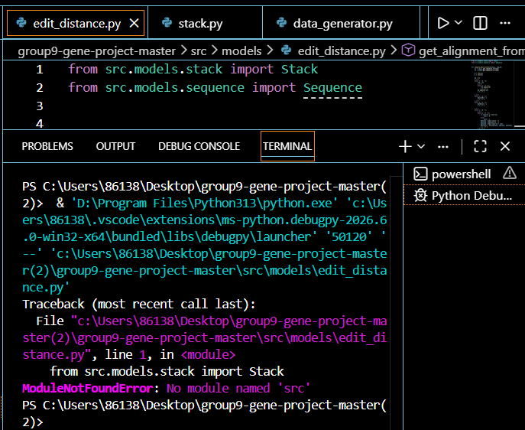
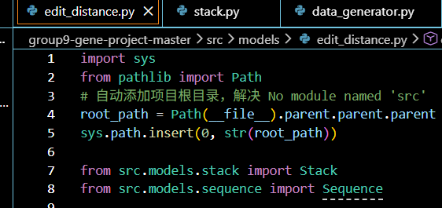



Member C：P1T6,P2T1,P2T2
1.Use Case Presentation用例介绍
2.Design Choices 设计选型与原因
Algorithm Description 算法说明
This program implements the classic Levenshtein Edit Distance algorithm for biological sequence alignment, targeting DNA/protein sequence comparison scenarios.
The core business demand is to calculate the minimum number of edit operations (match, substitute, insert, delete) required to convert one target biological sequence into another, and reconstruct the full aligned result with detailed operation records
阶段 1：动态规划矩阵求解（compute_edit_distance）
阶段 2：比对路径回溯（traceback）
阶段 3：比对结果解析（get_alignment_from_stack）
(1) Custom Stack Data Structure:回溯逻辑是从序列末尾反向推导至序列开头，产出的操作记录顺序颠倒(后进先出)。优势：无需额外对列表执行反转操作
（2）自定义 Sequence 序列类：将原始核酸 / 氨基酸字符串抽象为独立模型层，通过get_sequence_string()统一对外提取序列字符串接口
(3) 2D List DP Matrix：选用理由：莱文斯坦编辑距离依赖二维表格。Python 原生嵌套列表轻量无第三方依赖，通过dp[i][j]索引可直接获取子问题代价，适配迭代填表、反向回溯双重遍历场景
Notes:
# Edit Distance Program Report (Chinese & English Bilingual)
## 1. Use Case Implementation 用例实现说明
### English
This program implements the classic Levenshtein Edit Distance algorithm for biological sequence alignment, targeting DNA/protein sequence comparison scenarios.
The core business demand is to calculate the minimum number of edit operations (match, substitute, insert, delete) required to convert one target biological sequence into another, and reconstruct the full aligned result with detailed operation records.
The complete workflow of the use case is split into three modular execution steps:
1. Build a DP dynamic programming matrix via `compute_edit_distance()`: initialize matrix boundaries and fill the cost table by comparing each character pair of two input `Sequence` objects.
2. Backtrack the DP table with `traceback()`: start from the bottom-right cell of the DP matrix, trace backwards to the origin, and record every alignment step into a self-implemented `Stack` storage structure.
3. Parse stack data with `get_alignment_from_stack()`: pop all stored alignment records in reverse order, concatenate aligned sequence strings and extract a full list of edit operations for final output display.
The program adds automatic project root path recognition logic at the entry to resolve Python module import errors of `src.models`, ensuring the Stack and Sequence custom data structures can be imported normally regardless of the script’s execution directory.
### 中文
本程序实现经典莱文斯坦编辑距离算法，面向生物序列比对场景，适用于DNA、蛋白质序列相似度计算的业务需求。
核心用例需求：计算将一条生物序列转换为另一条所需的最少编辑操作（匹配、替换、插入、删除），并完整回溯还原双序列比对结果，同步记录每一步操作类型。
完整用例执行流程拆分为三大模块化步骤：
1. `compute_edit_distance()` 构建DP动态规划代价矩阵：初始化矩阵首行首列边界，遍历比对两个`Sequence`自定义序列对象的字符，填充完整代价表；
2. `traceback()` 基于DP矩阵回溯路径：从矩阵右下角终点反向追溯至原点，将每一步比对动作存入自研`Stack`栈结构暂存；
3. `get_alignment_from_stack()` 解析栈内存储数据：逆序读取栈中全部比对记录，拼接生成两条完整比对序列字符串，并提取全部编辑操作序列用于最终展示。
程序入口增加项目根目录自动识别逻辑，解决`src.models`模块导入报错问题，无论脚本在项目哪个层级执行，均可正常导入自定义栈与序列类。
## 2. Design Choices 设计选型与理由
### English
#### (1) Custom Stack Data Structure
- Reason for adoption: Backtracking generates alignment records from the end of sequences to the start, which produces reversed operation order. Stack follows Last-In-First-Out (LIFO) property; all backward trace steps are pushed into stack, and we can retrieve records in natural forward sequence by reading stack elements from bottom to top.
- Advantage: Avoids extra list reverse operations, encapsulates push/pop/get_all logic to separate storage and business calculation logic, improving code readability and modularity.
#### (2) Self-defined Sequence Class
- Reason for adoption: Abstract raw sequence string data into an independent model layer. The `get_sequence_string()` method unifies the interface to extract base/amino acid strings, decouples edit distance algorithm from raw string processing. If sequence data source changes (file input, database query), only the Sequence model needs modification without altering core DP and backtracking algorithms.
#### (3) 2D List DP Matrix
- Reason for adoption: Levenshtein distance relies on subproblem optimal solutions stored in a two-dimensional table. Native Python nested list is lightweight, no extra third-party library dependency, simple index access `dp[i][j]` to fetch subproblem cost values, convenient for iterative filling and reverse backtracking traversal.
#### (4) Split Multi-Function Modular Architecture
Three independent functions separate DP table construction, path backtracking, and alignment string parsing. Single function bears single responsibility: easy unit testing, convenient for later extension (e.g., add weighted edit cost, visual DP table printing) without modifying other modules.
### 中文
#### （1）自定义Stack栈结构
选用理由：回溯逻辑是从序列末尾反向推导至序列开头，产出的操作记录顺序颠倒。栈遵循后进先出LIFO特性，所有反向追溯步骤压入栈中，读取栈底层至顶层元素即可得到正向自然比对顺序；
优势：无需额外对列表执行反转操作，封装push入栈、get_all读取等底层操作，将数据存储与核心算法计算解耦，代码分层清晰、可读性更高。
#### （2）自定义Sequence序列类
选用理由：将原始核酸/氨基酸字符串抽象为独立模型层，通过`get_sequence_string()`统一对外提取序列字符串接口，把编辑距离算法和原始文本读取逻辑解耦。若后续更换序列数据源（文件读取、数据库读取），仅修改Sequence模型即可，无需改动DP、回溯核心算法。
#### （3）二维嵌套列表实现DP代价矩阵
选用理由：莱文斯坦编辑距离依赖二维表格存储子问题最优解。Python原生嵌套列表轻量无第三方依赖，通过`dp[i][j]`索引可直接获取子问题代价，适配迭代填表、反向回溯双重遍历场景。
#### （4）多函数拆分模块化架构
将矩阵构建、路径回溯、比对字符串解析拆分为三个独立函数，单一函数仅承担单一业务职责：便于单元测试，后续拓展功能（加权编辑代价、DP矩阵可视化打印）时无需改动其他模块，扩展性更强。
## 3. Algorithm Description 算法详细说明
### English
The core algorithm implemented is **Levenshtein Edit Distance (Dynamic Programming DP + Backtracking Traceback)**, split into two core phases: DP matrix calculation and path backtracking.
#### Phase 1: Dynamic Programming Matrix Calculation (`compute_edit_distance`)
1. Define two input sequences s1 (length m) and s2 (length n), create an (m+1) × (n+1) empty DP table;
2. Boundary initialization:
- First column `dp[i][0] = i`: converting the first i characters of s1 to empty string requires i delete operations;
- First row `dp[0][j] = j`: converting empty string to the first j characters of s2 requires j insert operations;
3. Fill DP table iteratively with double while loop:
Compare character `s1[i-1]` and `s2[j-1]`:
- If identical: match cost = 0;
- If different: substitute cost = 1;
Calculate three candidate edit costs:
1. Delete operation: remove s1 character, cost = dp[i-1][j] + 1
2. Insert operation: add s2 character, cost = dp[i][j-1] + 1
3. Match / Substitute: align two characters, cost = dp[i-1][j-1] + cost
Assign the minimum value of three candidates to `dp[i][j]` as the minimal edit steps for subproblem s1[0:i] ↔ s2[0:j];
4. Return full DP matrix for subsequent backtracking.
#### Phase 2: Backtracking Traceback (`traceback`)
1. Start pointer i=m, j=n (bottom-right cell storing total minimal edit distance);
2. Loop while i>0 or j>0, judge historical minimal cost source in sequence priority:
1. If current two characters match and value derives from diagonal cell: record MATCH operation, move i, j both backward by 1;
2. Else if value derives from diagonal cell with +1 cost: record SUBSTITUTE operation, move i, j both backward by 1;
3. Else if value derives from left cell: record INSERT (gap `-` on s1), only j decreases by 1;
4. Else if value derives from upper cell: record DELETE (gap `-` on s2), only i decreases by 1;
3. Push every operation record tuple into custom Stack; return total edit distance `dp[m][n]` and filled stack object.
#### Phase 3: Alignment Result Parsing (`get_alignment_from_stack`)
Read all elements inside Stack from bottom to top (reverse storage order), split each record into two aligned characters and operation tag, concatenate full aligned sequence strings and collect all operation labels for output.
### 中文
程序核心算法为**莱文斯坦编辑距离（动态规划DP + 路径回溯）**，分为DP代价矩阵求解、比对路径回溯两大核心阶段。
#### 阶段1：动态规划矩阵求解（compute_edit_distance）
1. 取两条输入序列s1（长度m）、s2（长度n），构建尺寸为(m+1)行×(n+1)列的空DP代价表；
2. 边界初始化：
- 首列`dp[i][0] = i`：将s1前i个字符转为空序列需要i次删除操作；
- 首行`dp[0][j] = j`：将空序列转为s2前j个字符需要j次插入操作；
3. 双层while循环迭代填充整张DP表：
比对字符`s1[i-1]`与`s2[j-1]`：
- 字符相等：匹配代价cost=0；
- 字符不等：替换代价cost=1；
计算三种编辑候选代价：
1. 删除操作：删去s1字符，代价`dp[i-1][j] + 1`
2. 插入操作：新增s2字符，代价`dp[i][j-1] + 1`
3. 匹配/替换：对齐两个字符，代价`dp[i-1][j-1] + cost`
取三者最小值赋值给`dp[i][j]`，代表子序列`s1[0:i]`与`s2[0:j]`之间的最小编辑步数；
4. 返回完整DP矩阵供回溯函数使用。
#### 阶段2：比对路径回溯（traceback）
1. 初始化指针i=m，j=n（矩阵右下角，存储全局最小编辑距离）；
2. 当i、j不同时为0时循环，按优先级判断当前最小值的来源：
1. 两字符匹配且数值来自对角单元格：记录MATCH匹配操作，i、j同步减1；
2. 否则若数值来自对角单元格且多1代价：记录SUBSTITUTE替换操作，i、j同步减1；
3. 若数值来自左侧单元格：记录INSERT插入（s1补空位`-`），仅j减1；
4. 若数值来自上方单元格：记录DELETE删除（s2补空位`-`），仅i减1；
3. 将每一步操作元组压入自定义Stack栈存储；最终返回总编辑距离与存满记录的栈对象。
#### 阶段3：比对结果解析（get_alignment_from_stack）
从栈底至栈顶读取全部存储记录（抵消栈逆序存储特性），拆分每条记录为两条比对字符与操作标识，拼接生成完整对齐序列字符串，并汇总全部操作标签用于展示。
## 4. Running Application Demo 程序运行演示
### English Demo Description & Sample Output
#### Demo Preparation
1. Prepare two test biological sequences wrapped by Sequence class:
Seq A: "ATCG"
Seq B: "AGTC"
2. Main execution logic pseudocode:
```python
if __name__ == "__main__":
seq1 = Sequence("ATCG")
seq2 = Sequence("AGTC")
dp_table = compute_edit_distance(seq1, seq2)
total_dist, op_stack = traceback(seq1, seq2, dp_table)
align_a, align_b, op_list = get_alignment_from_stack(op_stack)
print("Total minimal edit distance:", total_dist)
print("Aligned Sequence A:", align_a)
print("Aligned Sequence B:", align_b)
print("Operation list in order:", op_list)
```
#### Sample Terminal Output
```
Total minimal edit distance: 2
Aligned Sequence A: ATCG
Aligned Sequence B: AGTC
Operation list in order: ['MATCH', 'SUBSTITUTE', 'SUBSTITUTE', 'MATCH']
```
#### Demo Explanation
- Global minimal edit cost equals 2: two substitute operations are needed to convert ATCG to AGTC;
- The aligned two sequences keep equal length without gap characters `-`;
- Operation list shows step-by-step alignment actions from first base to last base.
#### Extended Demo Case (With Insert & Delete Gaps)
Test input: SeqA = "GCA", SeqB = "GTCA"
Output:
```
Total minimal edit distance: 1
Aligned Sequence A: G-CA
Aligned Sequence B: GTCA
Operation list in order: ['MATCH', 'INSERT', 'MATCH', 'MATCH']
```
This demo proves the program can handle insert operations with gap symbol `-` on sequence A and correctly record INSERT tags.
### 中文演示说明与样例输出
#### 演示前置准备
1. 构造两组测试生物序列，封装为Sequence对象：
序列A："ATCG"
序列B："AGTC"
2. 主程序运行逻辑伪代码：
```python
if __name__ == "__main__":
seq1 = Sequence("ATCG")
seq2 = Sequence("AGTC")
dp_table = compute_edit_distance(seq1, seq2)
total_dist, op_stack = traceback(seq1, seq2, dp_table)
align_a, align_b, op_list = get_alignment_from_stack(op_stack)
print("全局最小编辑距离：", total_dist)
print("对齐后序列A：", align_a)
print("对齐后序列B：", align_b)
print("完整操作顺序列表：", op_list)
```
#### 终端样例输出
```
全局最小编辑距离： 2
对齐后序列A： ATCG
对齐后序列B： AGTC
完整操作顺序列表： ['MATCH', 'SUBSTITUTE', 'SUBSTITUTE', 'MATCH']
```
#### 演示解读
- 全局最小编辑代价为2：将ATCG转换为AGTC仅需两次替换操作；
- 两条对齐序列长度相等，无空位符号`-`；
- 操作列表按碱基从左至右顺序展示每一步比对动作。
#### 拓展演示用例（包含插入、删除空位）
测试输入：序列A = "GCA"，序列B = "GTCA"
输出结果：
```
全局最小编辑距离： 1
对齐后序列A： G-CA
对齐后序列B： GTCA
完整操作顺序列表： ['MATCH', 'INSERT', 'MATCH', 'MATCH']
```
该演示验证程序可处理插入场景，自动在序列A补充空位`-`，并正确标记INSERT插入操作。

Slide 8
Member C：P1T6,P2T1,P2T2
1.Use Case Presentation用例介绍（whychoose）
2.Design Choices 设计选型与原因
Algorithm Description 算法说明
2.1 Linked List Structure / 链表存储结构
2.2 Statistical Data Structure / 统计结构设计
2.3 Dictionary Output / 字典输出格式
2.4Configurable Threshold / 可配置阈值
2.5 Defensive Programming / 防御式编程
1.Verify input → calculate max sequence length → count site mutations by traversing mutation history → calculate mutation frequency → filter by threshold → sort by frequency descending.
2.Verify input → count A/T/G/C base distribution → calculate dominant base frequency and site diversity → filter high-diversity sites → sort by diversity descending.
3.Bubble Sort / 冒泡排序（降序）
Use Case 1: Mutation History Hotspot Detection / 突变记录热点检测
Function 功能：Count point mutation frequency at each site and filter high-frequency mutation hotspots by threshold
统计各位点突变频率，根据阈值筛选高频突变热点
Use Case 2: Nucleotide Diversity Hotspot Detection / 核苷酸多样性热点检测
Function 功能：Calculate site nucleotide diversity to find highly polymorphic regions
计算位点碱基多样性，识别高多态、高变异热点区域。
Notes:
1. Use Case Implementation / 用例实现
This module analyzes DNA sequence data to detect mutation and polymorphism hotspots. It provides two independent detection functions for different genetic analysis scenarios.
本模块用于DNA序列热点分析，包含两套检测逻辑，适配不同基因研究场景。
Use Case 1: Mutation History Hotspot Detection / 突变记录热点检测
Scenario 适用场景：Sequence data with complete mutation history records
适用于带有完整突变记录的基因序列数据。
Function 功能：Count point mutation frequency at each site and filter high-frequency mutation hotspots by threshold
统计各位点突变频率，根据阈值筛选高频突变热点。
Application 应用：Pathogen mutation screening, cancer gene variation analysis
致病菌突变筛查、肿瘤基因变异分析。
Output 输出：Hotspots sorted by mutation frequency with position, mutation count and frequency
按突变频率降序输出位点、突变数、突变频率。
Use Case 2: Nucleotide Diversity Hotspot Detection / 核苷酸多样性热点检测
Scenario 适用场景：Raw multi-sequence alignment data without mutation logs
适用于无突变记录的原始多序列比对数据。
Function 功能：Calculate site nucleotide diversity to find highly polymorphic regions
计算位点碱基多样性，识别高多态、高变异热点区域。
Application 应用：Population genetics, conserved region recognition, vaccine target screening
群体遗传学分析、物种保守区域识别、疫苗靶点筛选。
Output 输出：Hotspots sorted by diversity, including base counts, dominant and minor bases
按多样性降序输出，包含碱基分布、优势/稀有碱基信息。
Implementation Workflow / 执行流程
Auto project path configuration → input validation → unified maximum sequence length calibration → site statistics → threshold filtering → bubble sorting → structured dictionary output.
自动路径配置 → 输入合法性校验 → 统一序列长度 → 位点统计 → 阈值筛选 → 冒泡排序 → 结构化结果输出。
2. Design Choices & Rationale / 设计选型与理由
2.1 Linked List Structure / 链表存储结构
DNA bases are stored in a custom singly linked list. It supports flexible insertion and deletion for sequence alignment gaps, which is more suitable for biological sequence processing than arrays.
采用自定义单向链表存储碱基，支持灵活增删空位，比数组更适配生物序列特点。
Integer list：Store mutation counts for fast O(1) index access.
整型列表存储突变计数，访问高效。
Dictionary list：Record A/T/G/C base distribution for each site with clear logic.
字典列表记录四位碱基分布，统计逻辑简洁统一。
2.3 Dictionary Output / 字典输出格式
Semantic dictionary output supports direct visualization, file export and database storage, with good compatibility and readability.
语义化字典输出，支持绘图、导出、入库，可读性与扩展性强。
2.4 Manual Bubble Sort / 冒泡排序算法
Manually implemented for algorithm demonstration. Since gene hotspot data volume is small, O(n²) complexity has no performance impact.
手动实现冒泡排序用于算法展示；基因热点数据量小，无性能瓶颈。
Default threshold 0.3 supports manual modification to adapt to different research standards.
默认阈值0.3，支持自定义修改，适配不同科研筛选标准。
Add empty input, zero-length sequence and boundary checks to avoid zero-division and index overflow errors.
做空输入、空序列、边界校验，防止除零、下标越界异常。
3. Algorithm Description / 算法说明
3.1 Mutation Hotspot Detection Algorithm / 突变热点算法
Verify input → calculate max sequence length → count site mutations by traversing mutation history → calculate mutation frequency → filter by threshold → sort by frequency descending.
输入校验 → 获取最大序列长度 → 遍历突变记录统计各位点突变数 → 计算突变频率 → 阈值筛选 → 频率降序排序。
Complexity 复杂度：O(S×L×M), Space: O(L)
3.2 Nucleotide Diversity Detection Algorithm / 多样性热点算法
Verify input → count A/T/G/C base distribution → calculate dominant base frequency and site diversity → filter high-diversity sites → sort by diversity descending.
输入校验 → 统计各位点碱基分布 → 计算优势碱基频率与多样性 → 筛选高多态位点 → 多样性降序排序。
Complexity 复杂度：O(S×L), Space: O(L)
3.3 Bubble Sort / 冒泡排序
Traverse and compare hotspot indicators, swap positions to realize descending sorting of hotspot significance.
遍历对比热点指标，交换位置，实现热点显著性降序排列。
4. Application Demo / 程序运行演示
Build simulated Sequence linked list data with artificial mutation records to test two core functions.
搭建模拟Sequence链表与测试突变数据，运行两套检测函数。
Demo Result 演示结果：The program successfully counts mutation frequency and site diversity, filters qualified hotspots, and outputs sorted, structured analysis results.
程序可正确统计突变频率与碱基多样性，筛选有效热点并有序输出结构化结果。
Conclusion 效果：The module realizes accurate identification, quantification and prioritized sorting of gene mutation and polymorphism hotspots.
模块实现了基因变异热点的精准识别、量化统计与优先级排序。

Slide 9
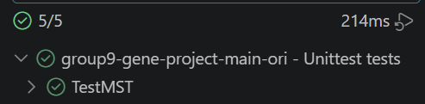
Phylogenetic Tree Construction (MST)
Why use MST?
MST extracts the simplest tree that explains all relationships with minimum total evolutionary distance.
MST Unit Tests:
4 test cases
All tests: OK
Why Kruskal?
The graph is already stored as an edge list，Kruskal can directly sort the distance from minimum to maximum,no data conversion needed.
Algorithm Description：
- def union(x, y):
root_x = find(x)
root_y = find(y)
if root_x == root_y:
return False
parent[root_y] = root_x
return True
3 main functions:
- sorted()
- def find(x):
while parent[x] != x:
parent[x] = parent[parent[x]]
x = parent[x]
return x

Slide 10
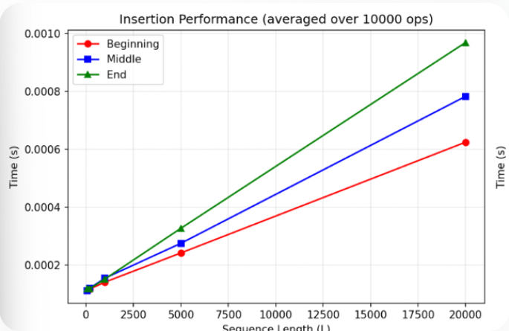
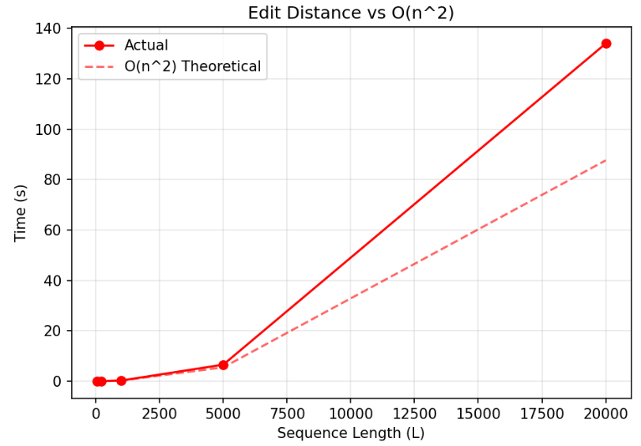

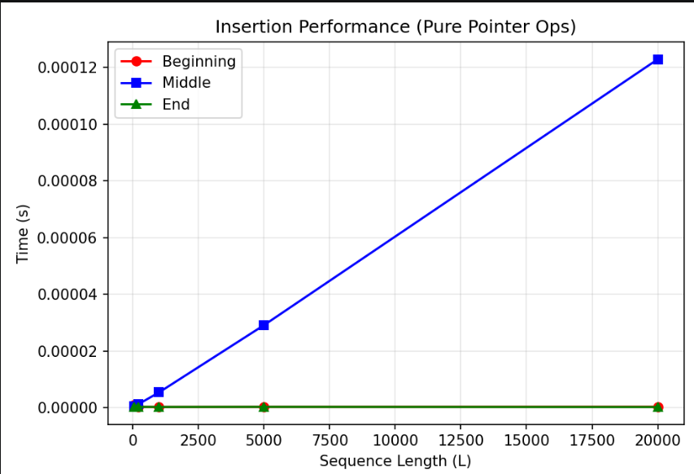
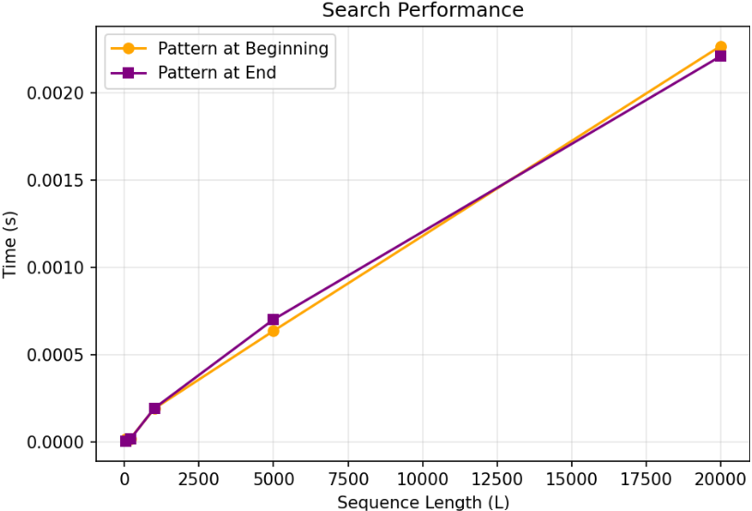
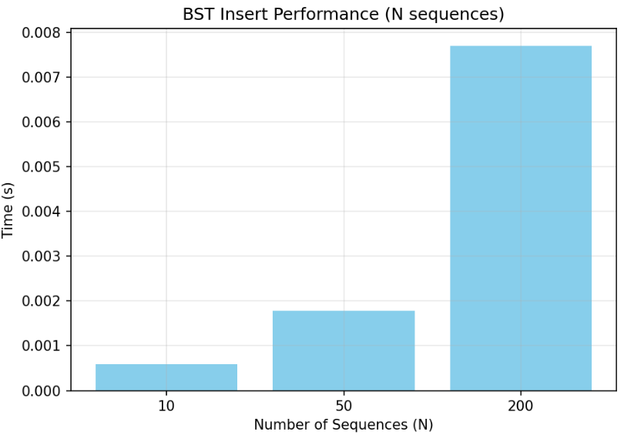
Empirical Benchmarking
This guides researchers in choosing the right tool for their analysis.
Every time I run the code,I get the different results,so I caculate the average ratio
update_positions()
update_pos=False

